Slide 1


TNL AFRICA · CORPORATE SERVICES
Your partner in East & Central Africa
Market entry, investor relations and project management, delivered by one regional team on the ground.
MARKET ENTRY
INVESTOR RELATIONS
PMO
INNOVATE · EXCEL · DELIVER
tnl-af.com
Notes:
TNL Africa is a regional partner for international companies, investors and corporate clients in East and Central Africa. This deck brings together our three service areas: market entry and business support, investor relations and investment assessment, and our Project Management Office.

Slide 2






Three service areas, one accountable regional partner
INTRODUCTION
01
02
03
Market Entry & Business Support
Investor Relations & Investment Assessment
Project Management Office (PMO)
Establish a local presence, identify projects and launch operations.
Assess companies, projects and developments before capital is committed.
Plan, control and report every project from one accountable office.
Entry strategy and establishment
Project intelligence and business development
Operational setup and local representation
Opportunity screening and investigation
Partner and project due diligence
Board-ready findings and launch plan
Twelve integrated PMO services
Controls for project-based operations
Monthly reporting via your Africa Desk
Notes:
The three service areas can be used on their own or together. A typical journey: we help a company or investor assess and enter a market, and our PMO then controls delivery of the projects that follow — with the same team and the same Africa Desk throughout.

Slide 3

A local team for your regional ambitions
WHO WE ARE
TNL Africa supports international companies, investors and corporate clients across East and Central Africa. We combine regional operating experience with practical knowledge of construction, energy, logistics and infrastructure — the right market, the right partners and a clear path to launch.
10
15
3
1
Countries
Sectors
Service areas
Africa Desk
across East, Central and Southern Africa
of hands-on project and operating experience
market entry, investor relations and PMO
a named consultant and regular reporting
Notes:
Our credentials: ten countries, fifteen sectors of hands-on experience, three service areas and a dedicated Africa Desk with a named consultant.

Slide 4
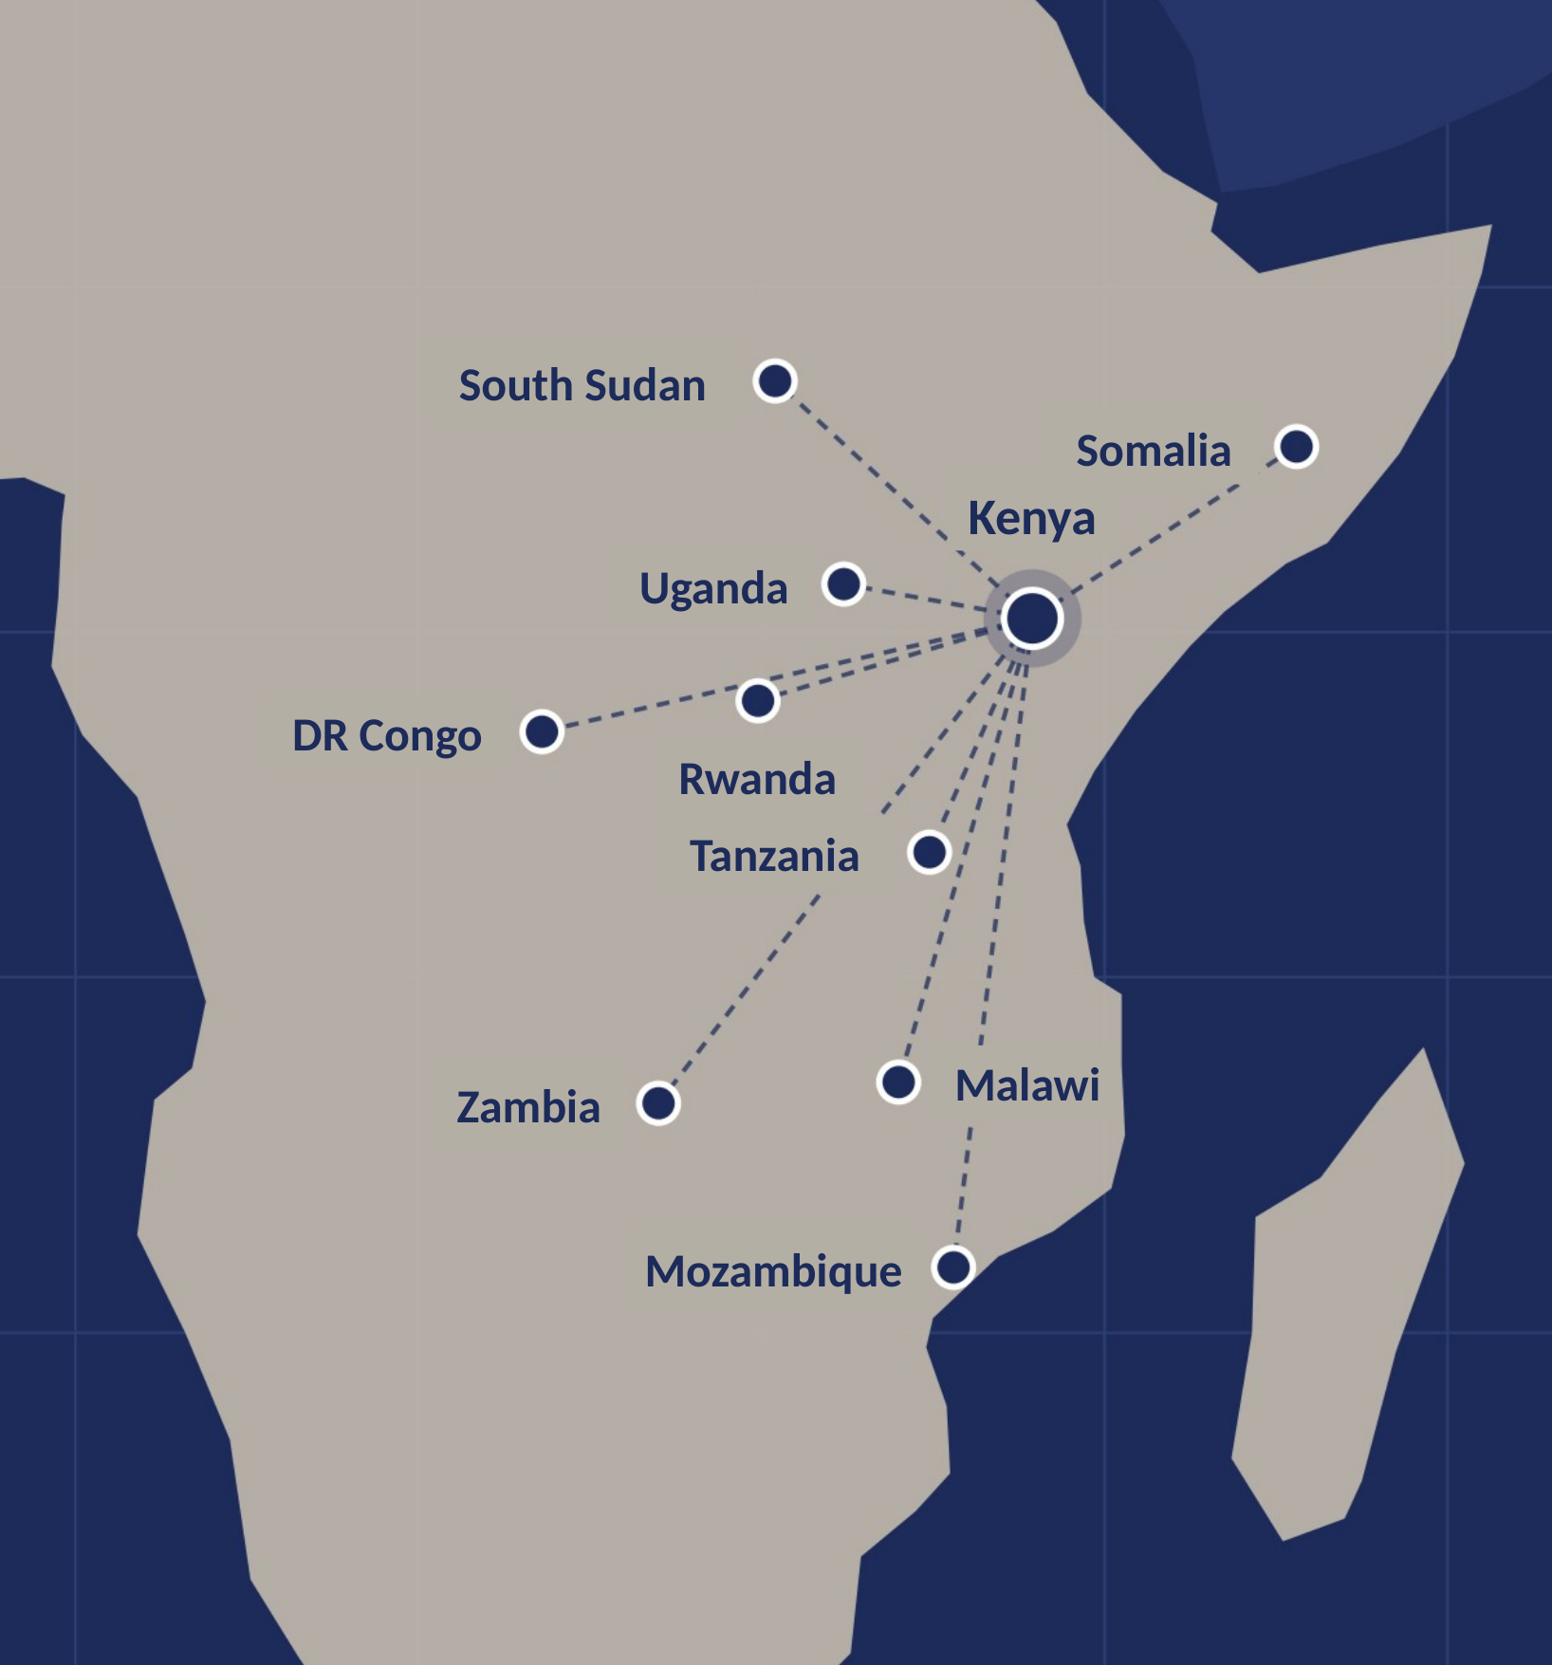



Ten markets, one regional partner
REGIONAL FOCUS
01 Kenya
02 Uganda
03 Tanzania
04 Rwanda
05 South Sudan
06 Somalia
07 DR Congo
08 Zambia
09 Malawi
10 Mozambique
Where to enter
Who to work with
How to operate
Country and sector assessment, customer demand and route to market.
Partner screening, stakeholder mapping and commercial introductions.
Establishment coordination, local resources and ongoing representation.
Additional markets by agreement and client need. Each assignment's local delivery team and advisers are agreed before mobilization.
Notes:
Our core footprint covers ten markets from the Horn of Africa to Mozambique. Every engagement starts with three questions: where to enter, who to work with, and how to operate.

Slide 5
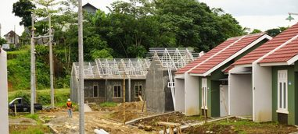




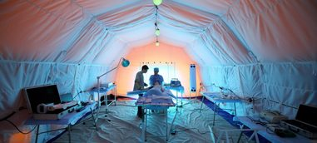


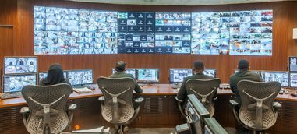
Sectors we know from the inside
SECTOR EXPERIENCE
Services shaped around your product, customers and project requirements — backed by hands-on project and operating experience.
01 Construction & civil works
02 Camps: design, build & manage
03 Modular construction
ALSO
Oil & gas support
Mining, industrial & manufacturing
Agriculture & food security
04 Hospitality & residential
05 Renewable energy & water
06 Healthcare
EV solutions
Aviation
Technology & telecoms
07 Logistics & cold chain
08 Last-mile solutions
09 Security & defence
Notes:
Fifteen sectors of hands-on experience. The people supporting your market entry, assessing your investment or running your project controls have worked inside construction sites, camps, energy plants, clinics and supply chains in the region.

Slide 6


From first assessment to an established local presence
01 · MARKET ENTRY & BUSINESS SUPPORT
01
02
03
04
05
Market entry
Project intelligence
Business development
Operational setup
Local representation
Entry strategy, subsidiary or branch establishment coordination and launch planning.
Relevant projects, procurement tracking and decision-maker research.
Customer introductions, partner identification, due diligence and follow-up.
Premises, staffing coordination, supplier sourcing and logistics support.
A retained Africa Desk with a named consultant and regular reporting.
MARKET ENTRY & OPERATIONAL LAUNCH
1
Assess
2
Establish
3
Mobilize
4
Launch
Prioritize markets and define the commercial proposition.
Coordinate incorporation, permits and professional advisers.
Source premises, people, suppliers and local operating support.
Track readiness, resolve open actions and support first customers.
Licensed local specialists provide legal, tax and other regulated advice.
Notes:
Five core services that can be used individually or combined, depending on where you are in your market entry journey. Our launch workplan moves through four stages: assess, establish, mobilize and launch.

Slide 7









Project intelligence that supports action
01 · MARKET ENTRY & BUSINESS SUPPORT
A focused pipeline matched to your capabilities and target markets
PROJECT RECORD
CLIENT OUTPUT
What we track
What you receive
Country and sector
Prioritized opportunities
Developer and funder
Evidence and source links
Project stage and procurement route
Recommended next steps
Relevant stakeholders and contacts
Regular pipeline review
Notes:
Every project we track is captured in a consistent record, then turned into a prioritized, evidence-backed pipeline for you — feeding business development and, for investors, the assessment work on the next slides.

Slide 8


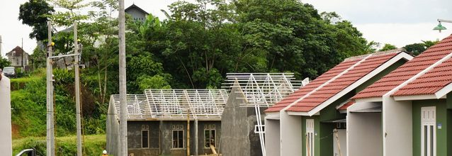
Three types of opportunity, one disciplined assessment
02 · INVESTOR RELATIONS & INVESTMENT ASSESSMENT
We assess opportunities for investors, so every decision rests on local evidence and verified partners
Companies
Projects
Developments
Acquisitions, joint ventures and local partners.
Infrastructure, energy, industrial and tendered projects.
Residential, commercial, camps and modular developments.
Partner and counterparty screening
Due diligence coordination
Stakeholder mapping
Customer demand and route to market
Pipeline and procurement tracking
Decision-maker research
Budget, schedule and cost review
Supply chain and logistics feasibility
Site, demand and market assessment
BOQ and cost-plan review
Contractor and supplier evaluation
Incorporation, permits and advisers
Notes:
Whether the investor is buying into a company, backing a project or funding a development, TNL applies the same discipline: verify the market, verify the counterparties, verify the numbers.

Slide 9

From first screen to investment decision
02 · INVESTOR RELATIONS & INVESTMENT ASSESSMENT
01
Screen
Prioritize markets and sectors, and define the investment case and the criteria it must meet.
02
Investigate
Country and sector assessment, customer demand, project intelligence and access to decision-makers.
03
Verify
Partner and project due diligence, plus cost, schedule and supply-chain review. Licensed local specialists provide legal, tax and regulated advice.
04
Recommend
Clear findings, an entry structure and a launch plan, so the board can decide with confidence.
AFTER THE DECISION
Our Project Management Office can oversee delivery — budgets, procurement, progress and budget-versus-actual reporting, with monthly updates from your Africa Desk.
Notes:
Four steps take an opportunity from first screen to a board-ready recommendation. Each assignment defines evidence sources, verification limits and any specialist advice required. The link to our PMO is the differentiator: the team that assessed the investment can then control its delivery.

Slide 10


One office to plan, control and report every project
03 · PROJECT MANAGEMENT OFFICE
We reconcile twelve enterprise service lines into a single Project Management Office — so finance, people, supply, assets, operations and reporting run as one governed system, with a named TNL consultant accountable to you.
12
4
1
Integrated services
Service pillars
Accountable office
from project controls to analytics
plan, source, build, report
with a named TNL consultant
Access control across every module: role-based permissions, approval authority, audit trails and data security.
Notes:
The core proposition. Clients usually manage these functions in separate systems and teams. The PMO consolidates them into twelve service categories under four pillars and runs them from one office. Access control is not a separate department; it is a system-wide capability.

Slide 11




Twelve services, four pillars, one office
03 · PROJECT MANAGEMENT OFFICE
A · PLAN & GOVERN
B · SOURCE & SUPPLY
C · BUILD & OPERATE
D · ENGAGE & REPORT
01 Project Management
04 Purchasing & Procurement
07 Engineering & Production
10 Customer Relationships
Planning, budgets, schedules, resources, costing, subcontractors
Requisitions, RFQs, purchase orders, approvals, supplier evaluation
Engineering workflows, BOMs, MRP, production planning, QC, PLM
Leads, pipeline, quotations, contracts, customer service
02 Finance & Accounting
05 Inventory & Warehouse
08 Asset & Equipment
11 Documents & Data
Ledger, payables, receivables, cash flow, tax, cost accounting
Stock control, goods received, transfers, reorder levels, valuation
Asset register, maintenance, repairs, depreciation, utilization
Document control, approvals, version control, ECM, PDM
03 Human Resources
06 Supply Chain & Logistics
09 Operations & Resources
12 Reporting & Analytics
Records, payroll, recruitment, attendance, training, benefits
Supply planning, transport, shipping, import / export tracking
Service management, work orders, scheduling, resource use
MIS, dashboards, KPIs, business intelligence, GIS
Notes:
The twelve PMO service categories consolidate overlapping functions from three ERP reference models. Implementation is phased: core services first (project management, finance, HR, procurement, inventory, reporting), then control and specialized modules.

Slide 12

Built for project-based operations
03 · PROJECT MANAGEMENT OFFICE
For construction, engineering and other project-based clients, the PMO scope explicitly includes:
01
BOQ management and project cost codes
02
Subcontractor payment tracking and certifications
03
Variation orders and change management
04
Progress certificates and site progress reporting
05
Site material requests, issuance and stock tracking
06
Equipment allocation, utilization and maintenance
07
Project budget-versus-actual cost reporting
Notes:
These seven controls are where generic ERP setups usually fall short on project-based work. TNL Africa brings them as standard, drawing on construction and civil works, camps, modular construction and oil and gas support experience.

Slide 13








Your Africa Desk and flexible engagement options
WORKING WITH TNL AFRICA
ONGOING REPRESENTATION
Monthly retainer
Fixed assignment
Your TNL Africa Desk
Ongoing intelligence, representation, business development or PMO support with agreed scope and reporting.
Market assessments, entry planning, due diligence or setup with defined deliverables.
A dedicated point of contact in the region. Your named consultant keeps priorities moving between visits.
Opportunity monitoring and market updates
Hourly advisory
Success-based
Local meetings and commercial follow-up
Targeted senior advice and additional support when required.
Where appropriate, a separately agreed fee with clear triggers and terms.
Partner, supplier and stakeholder coordination
Monthly reporting against agreed priorities
Every proposal specifies fees, hours, expenses and third-party costs.
Notes:
All three service areas are delivered through the Africa Desk, with a commercial model that fits the client. Most clients start with a fixed assignment — such as a market or investment assessment — and move to a monthly retainer.

Slide 14
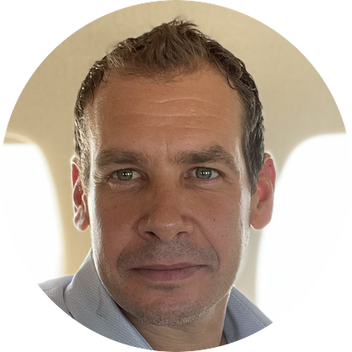



Our consultants
THE TEAM
Omri Cohen
Paul Williamson
Ruth Kamau
Rotem Yaniv-Cohen
CO-FOUNDER & CEO
CONSULTANT
CONSULTANT
CONSULTANT
Builds and manages businesses across East Africa, with a background in cleantech, renewable energy and construction delivery, applied to market entry and project development.
Has built and scaled businesses in the UK and East Africa across construction, manufacturing and assembly, including EVs, charging and solar. Brings procurement and construction networks.
Experience across strategic growth, partnerships, procurement and logistics. Connects clients' commercial plans with the local suppliers and resources needed to operate.
Nairobi business development, market research, strategy analysis and project coordination. Educated in Kenya and fluent in English and Hebrew; brings local, cross-cultural context.
Notes:
Omri leads TNL Africa; Paul brings construction, manufacturing and EV experience; Ruth covers partnerships, procurement and logistics; Rotem brings market research, strategy and cross-cultural communication.

Slide 15




WORKING WITH TNL AFRICA
Your next step
1
Introductory discussion
Arrange a call with your TNL consultant.
2
Share your goals
Your target market, investment or projects, priorities and timing.
3
Receive a tailored proposal
Scope of work, delivery team and fee structure.
tnl@tnl-af.com
+254 719 500 532
tnl-af.com
INNOVATE · EXCEL · DELIVER
Notes:
Close by proposing an introductory call. Ask the client to share their target market, the investment they are considering or the projects their PMO would cover, then follow up with a tailored proposal. Leave contact details on screen during questions.

